Slide 1
Dataset Description
Bike Rentals
Modeling and Predicting
Source: UCI Machine Learning Repository
Date Range: January 1, 2011 – December 31, 2012, 731 daily records
Target Variable: cnt: Total bike rentals per day (casual + registered)
Feature Types:
Categorical: season, year, month, holiday, weekday, workingday, weather situation
Continuous (normalized): temperature, “feels like” temp, humidity, windspeed
Caveats:
Data limited to Washington D.C. only
Some subjective classifications (e.g. weather categories)
Holidays are binary and may lack cultural nuance
Ruocheng Jiang
Prescriptive Analytics
Notes:
Hi everyone. Today, I’ll be presenting an analysis on bike rental prediction using a dataset from the UCI Machine Learning Repository. The goal is to model and predict the target variable—CNT—which represents the total number of bike rentals per day.

Slide 2

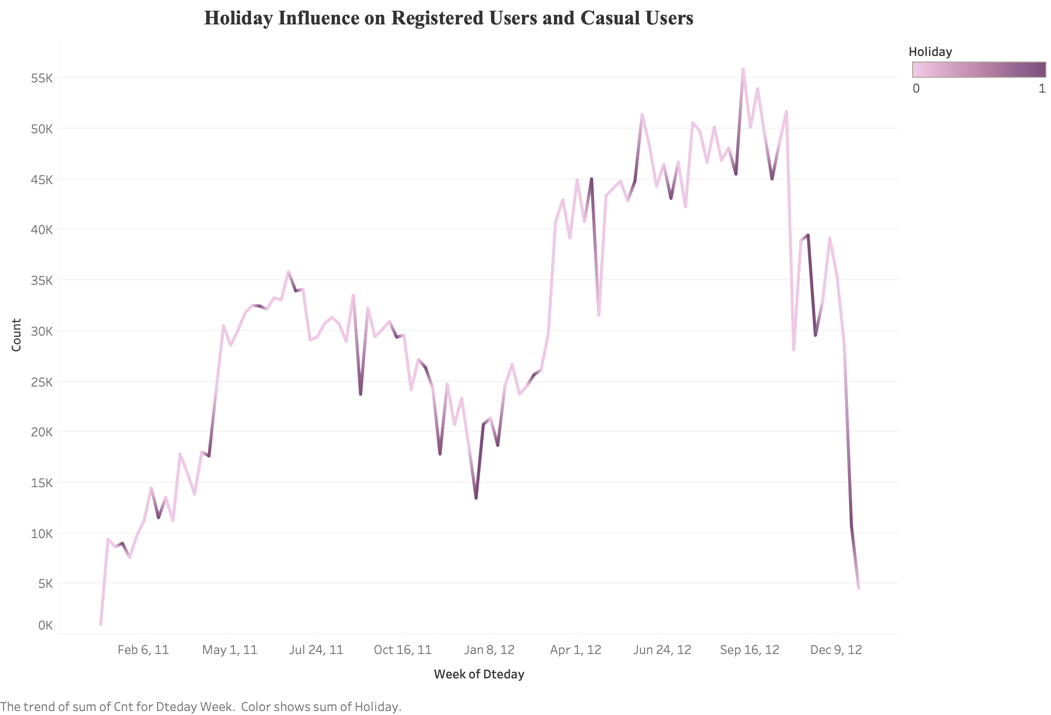
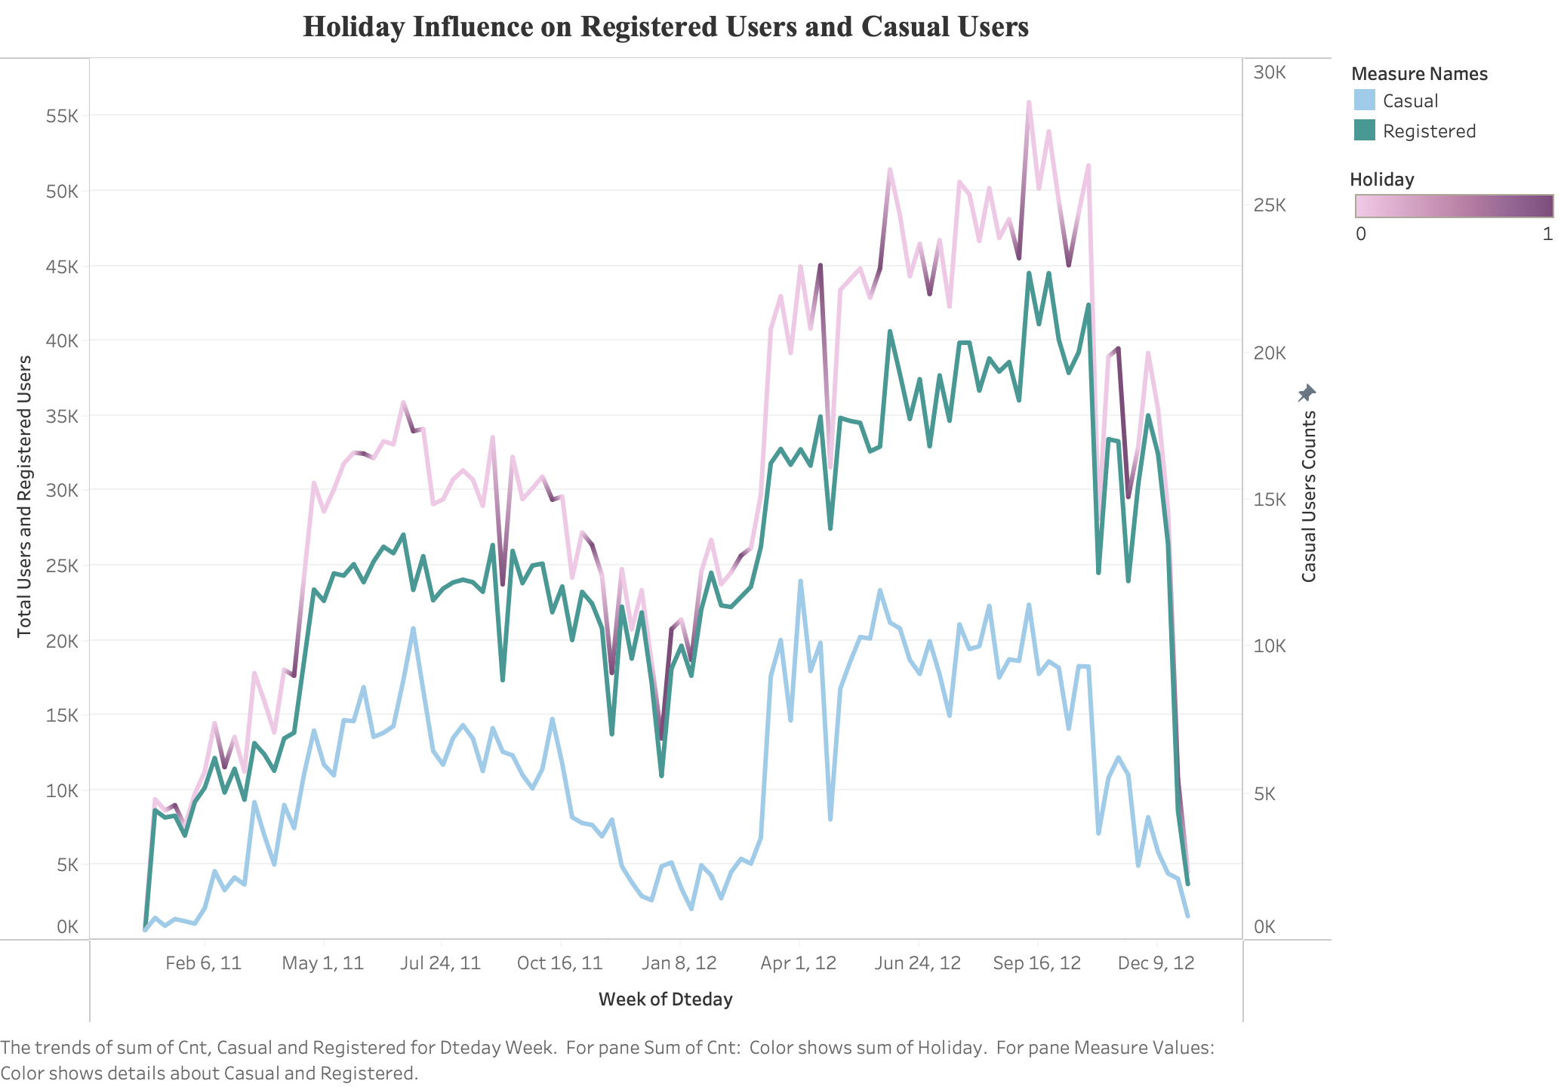
Initial Trend Exploration
Hypothesis:
Holidays may influence ridership
Rentals are more in summer, less in winter
Notes:
First, I used Tableau to explore how the overall trend of bike rentals fluctuated weekly. This helps identify any consistent patterns or trends that might affect rental behavior.
Since it's reasonable to assume that people are more likely to go out or travel during holidays, I added the "Holiday" variable to the visualization. To further explore potential behavioral differences, I broke the data down into two user types: registered and casual.

Slide 3
Initial Trend Exploration in Tableau
Hypothesis:
Holidays may influence ridership
Rentals are more in summer, less in winter
Notes:
This allowed me to observe which group might be more sensitive to holidays.
To get more details, I also created comparative bar charts

Slide 4
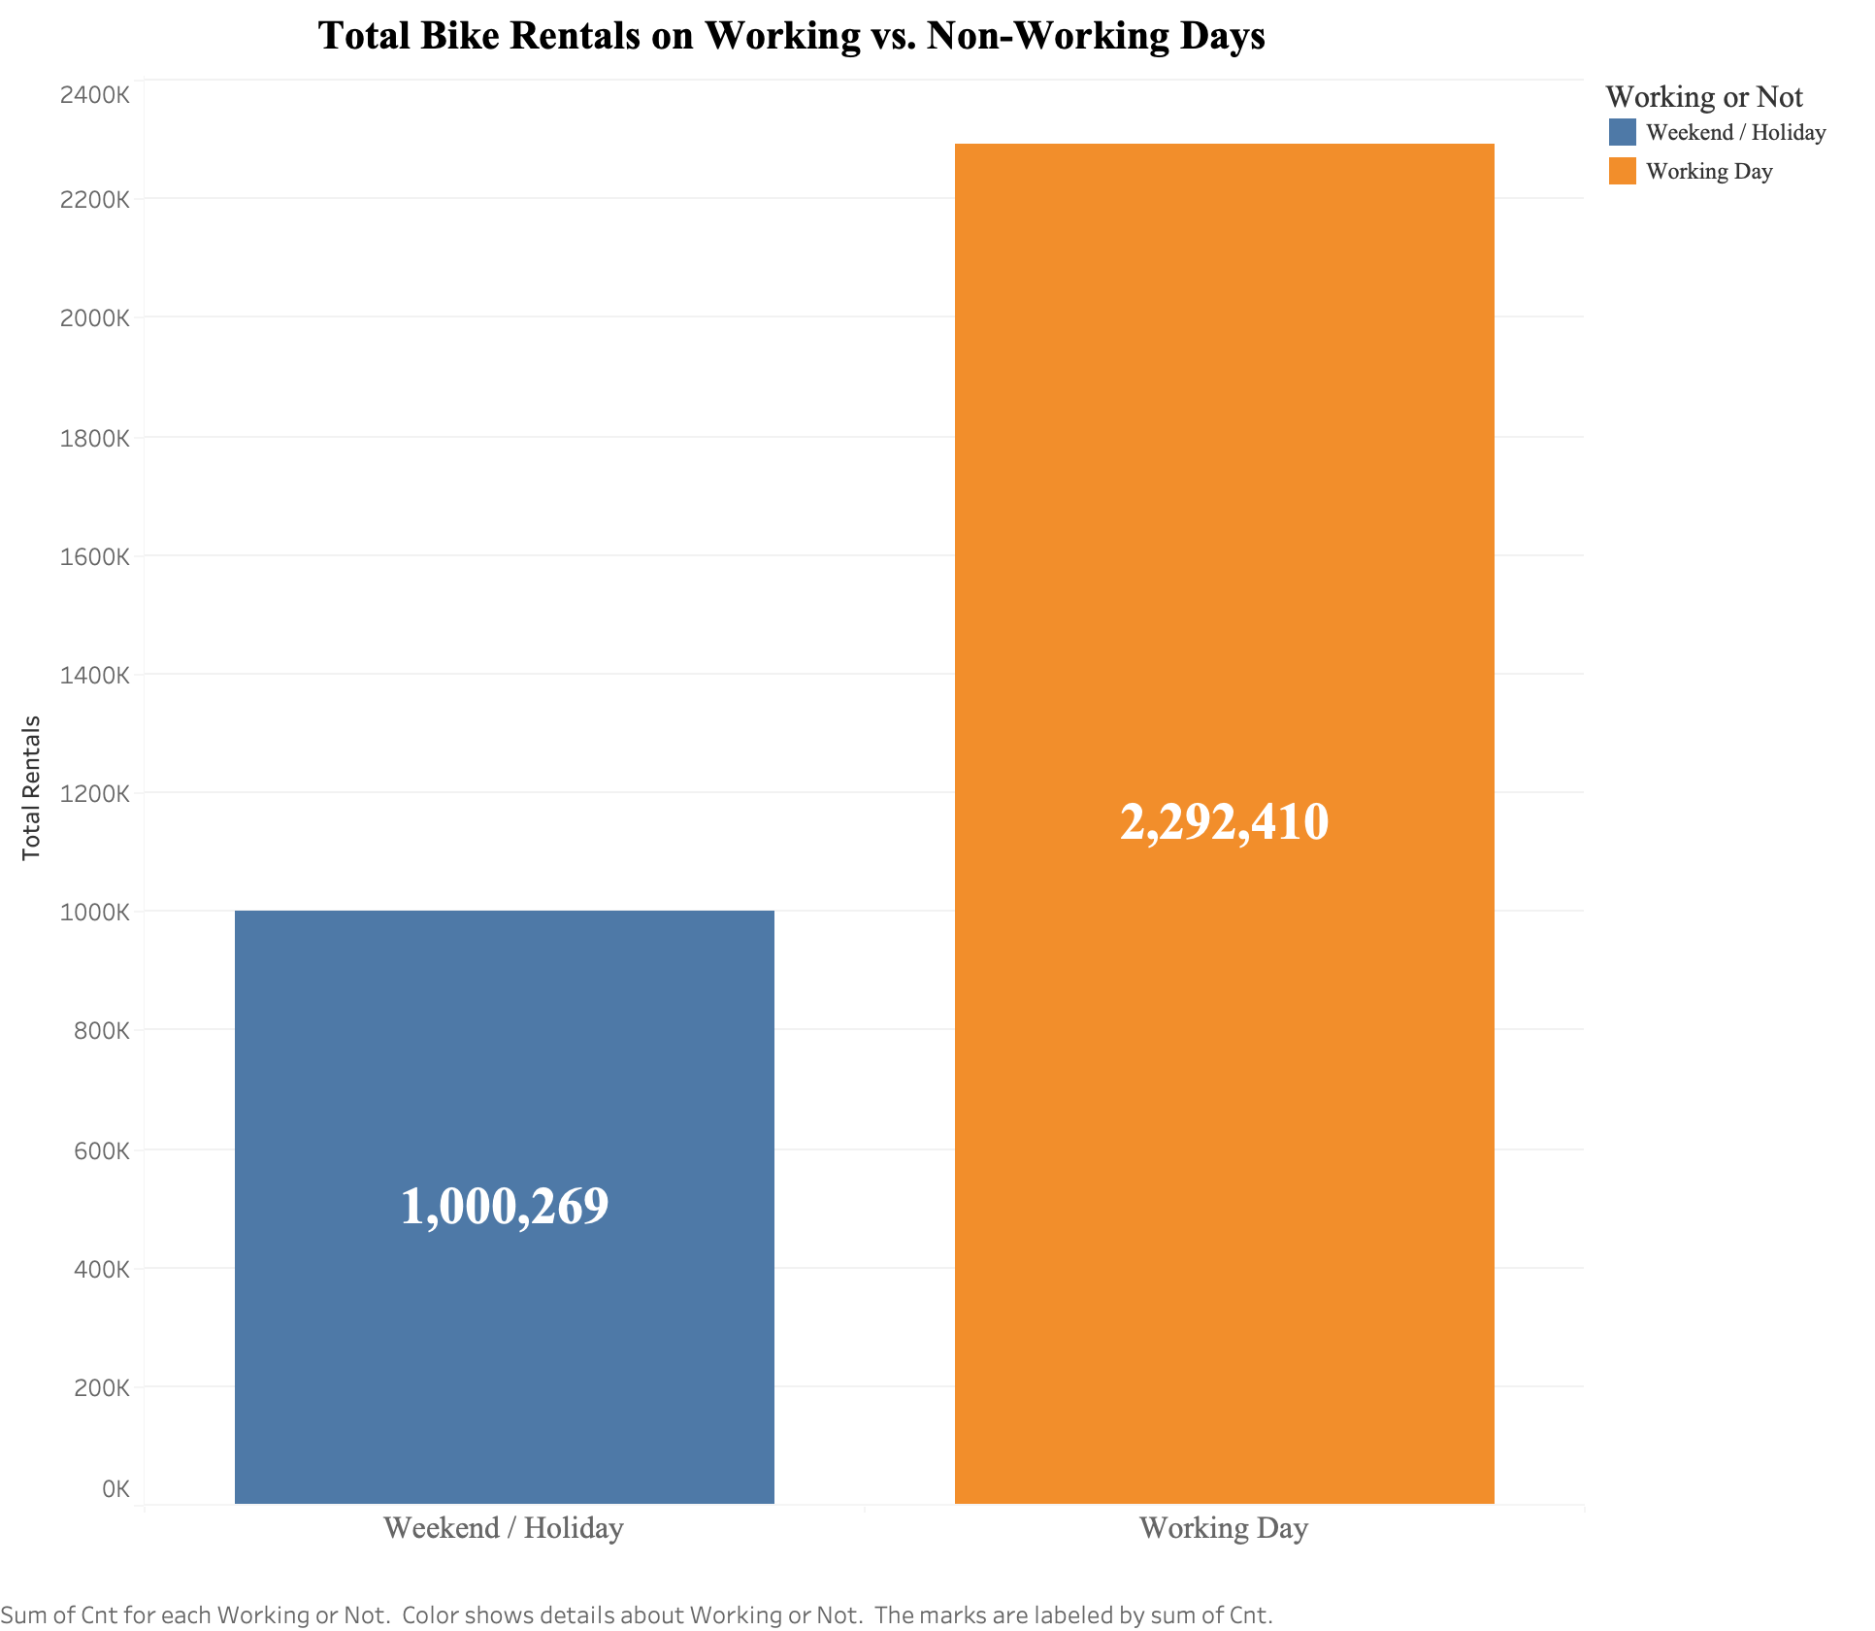
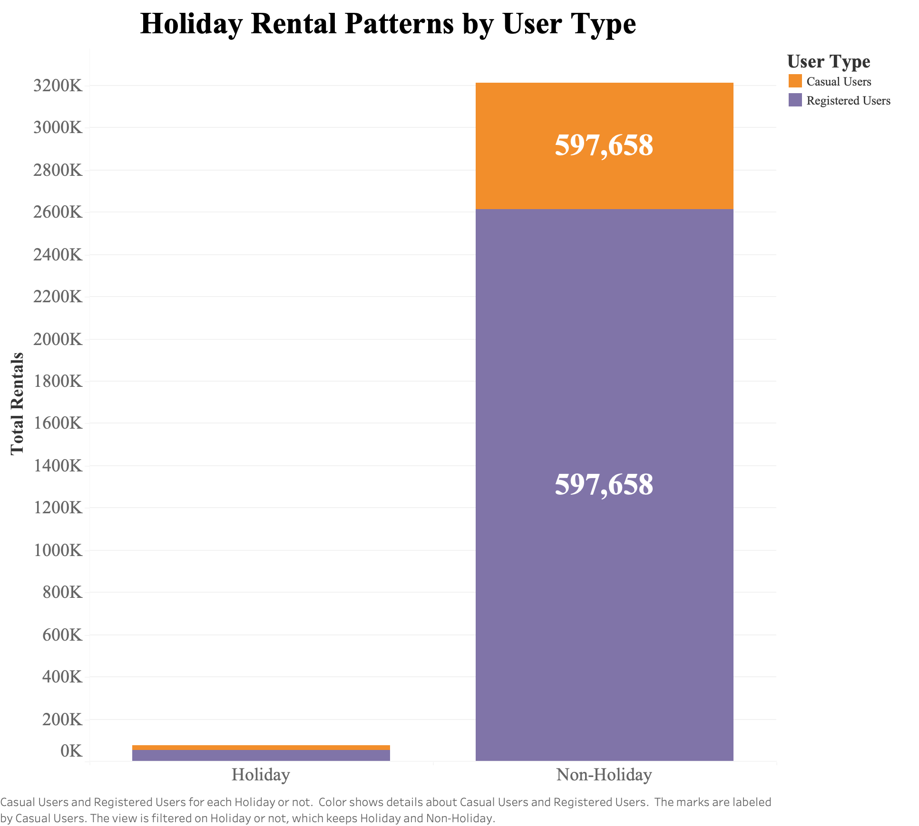
Total Bike Rentals on Working vs Non-Working Days
Rentals are significantly higher on working days
Bike sharing is primarily used for commuting purposes rather than leisure
Daily transportation habits.
Registered users tend to dominate overall volume and maintain high rental counts regardless of the day type.
*Help with targeted promotions or resource allocation.
Notes:
on the left we see that working days have more total rentals, so people rent bikes mainly for working and commuting purposes instead of hanging out or travelling.
On the right, while registered users dominant the pattern during non holidays,
… travelers from other cities or countries.
I then moved on to explore seasonality and temperature.

Slide 5
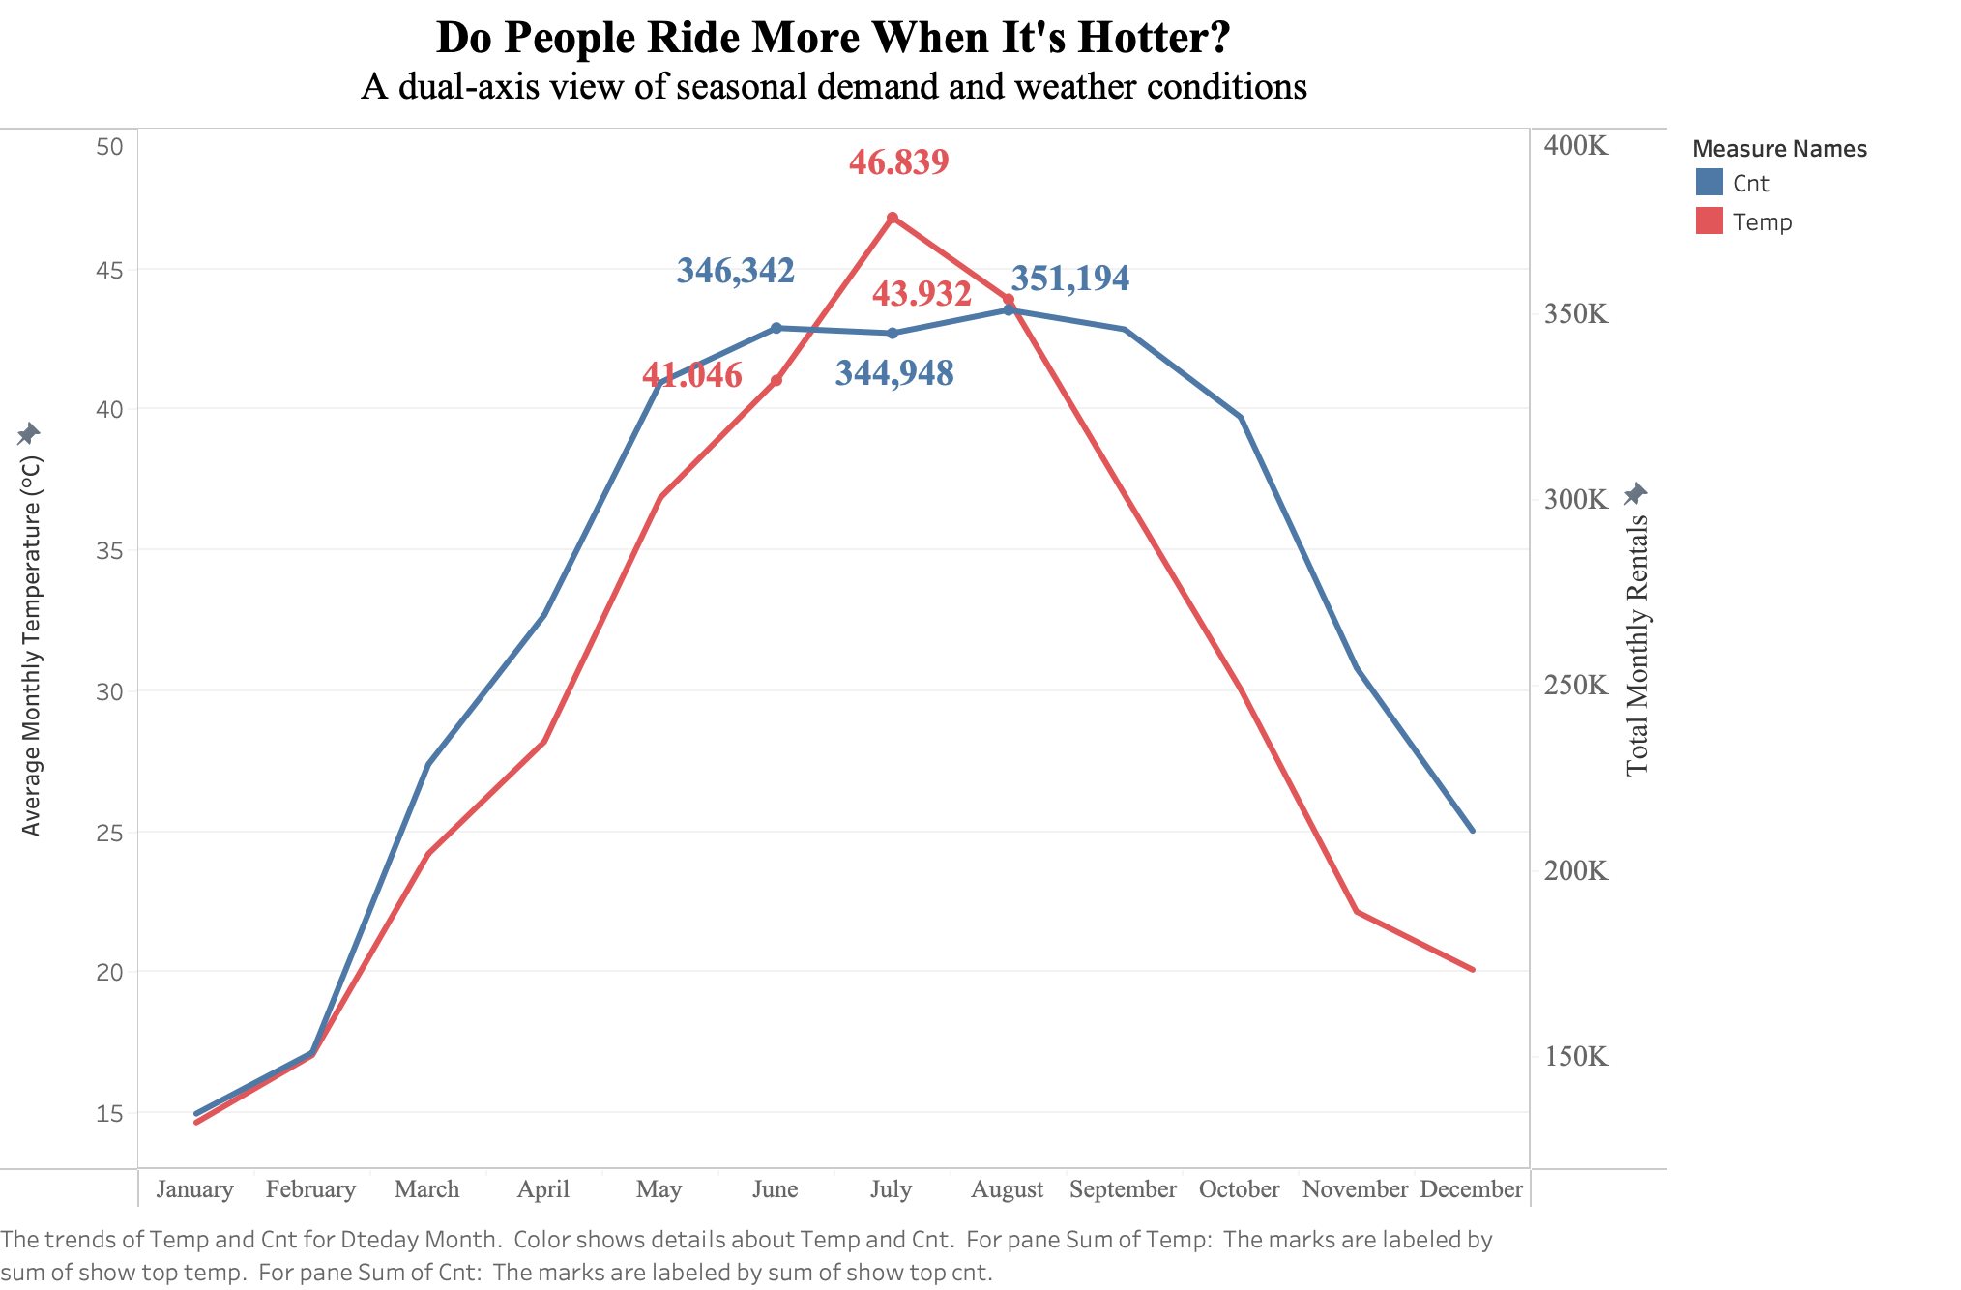
Inverted U-shaped pattern between temp and rentals
Moderate warmth boosts rentals
Overheating suppresses demand.
Notes:
From this dual axis line chart
To validate this idea, I broke rentals down by season and weather condition

Slide 6
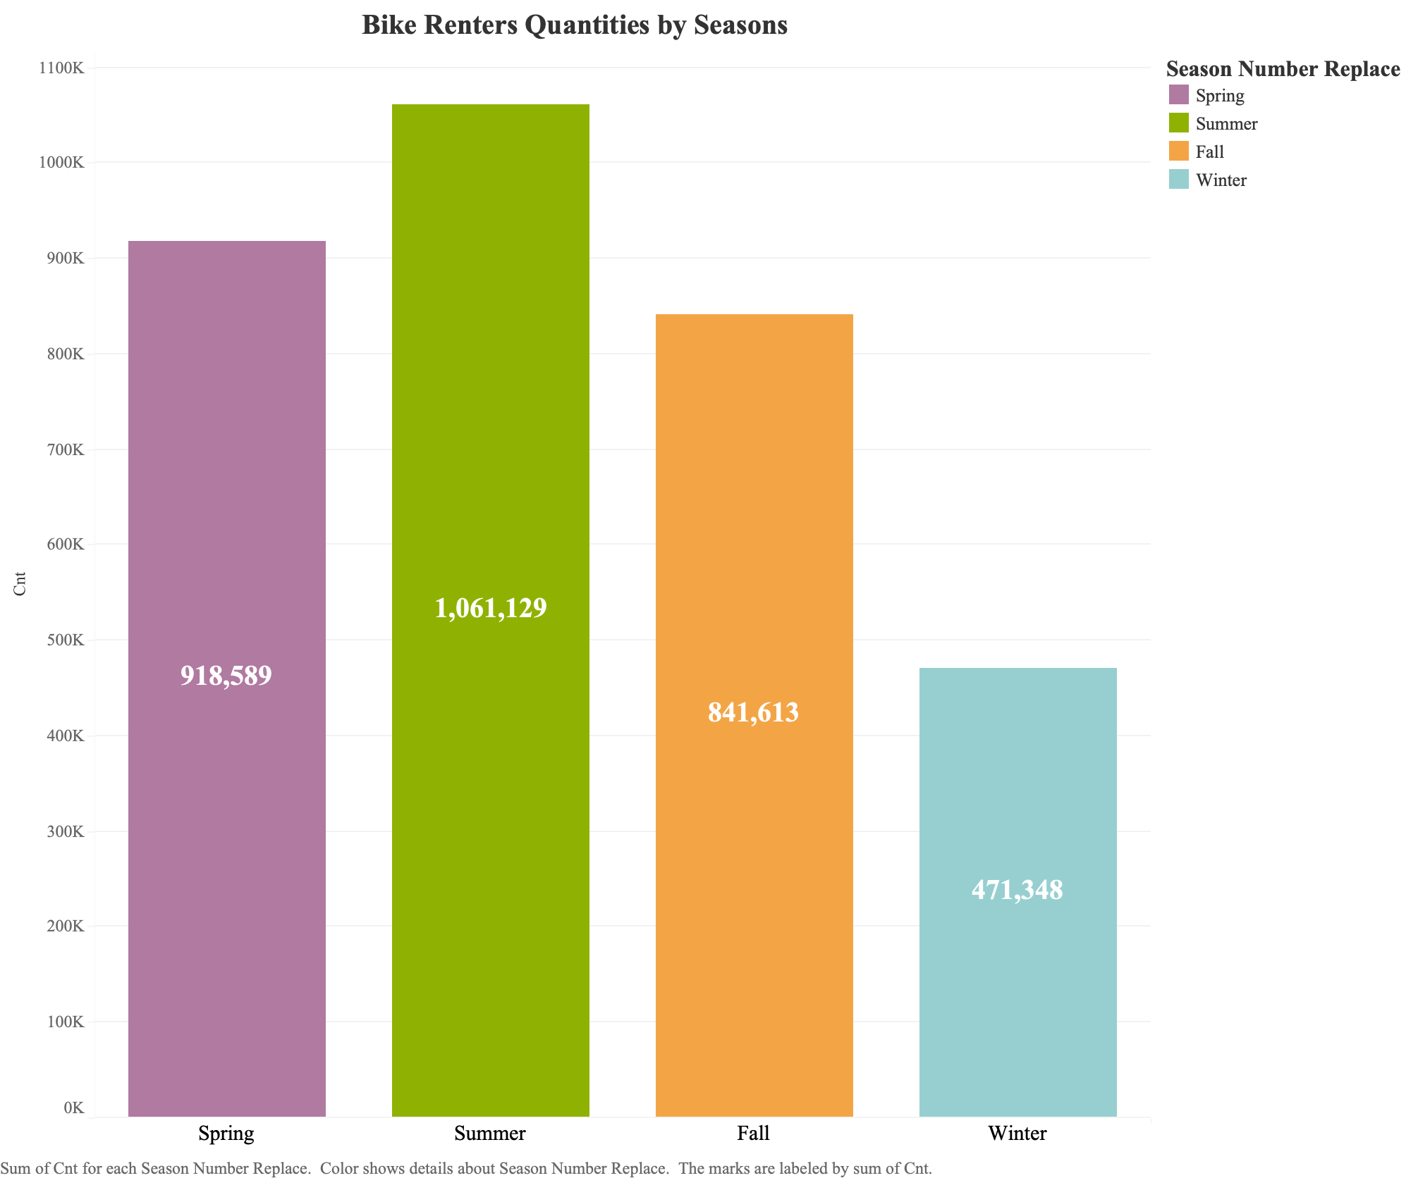
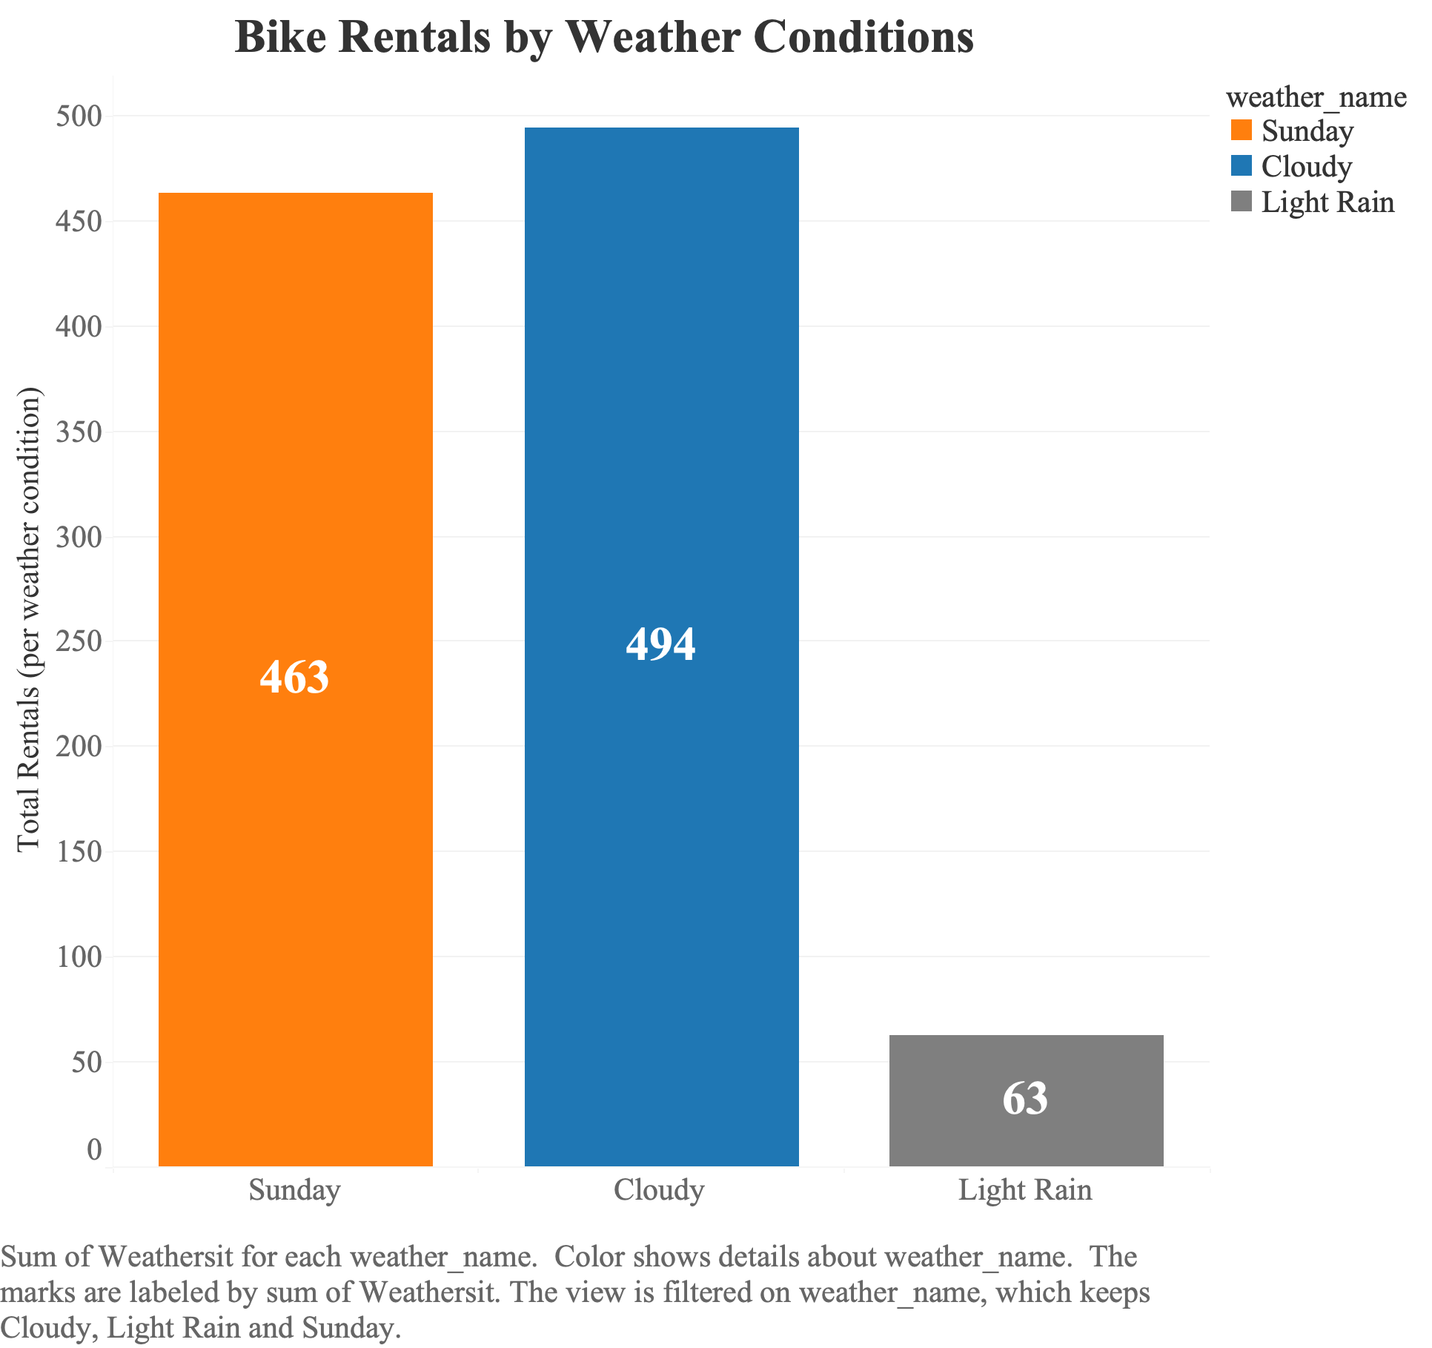
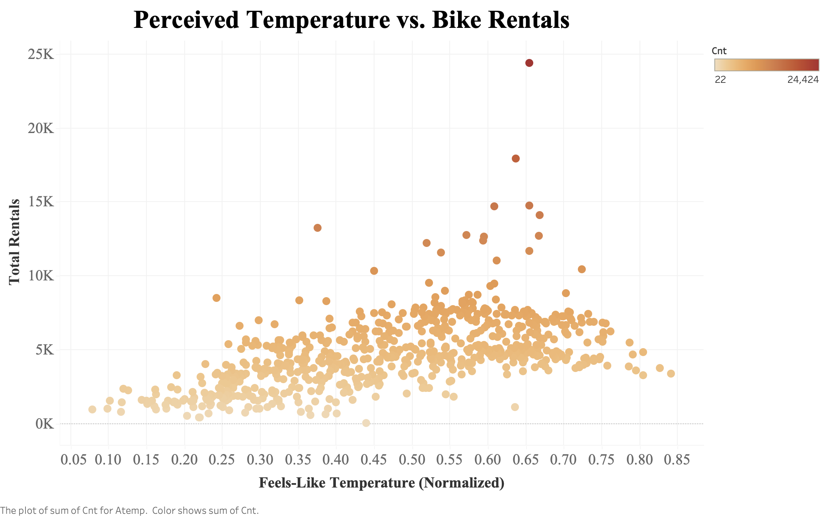
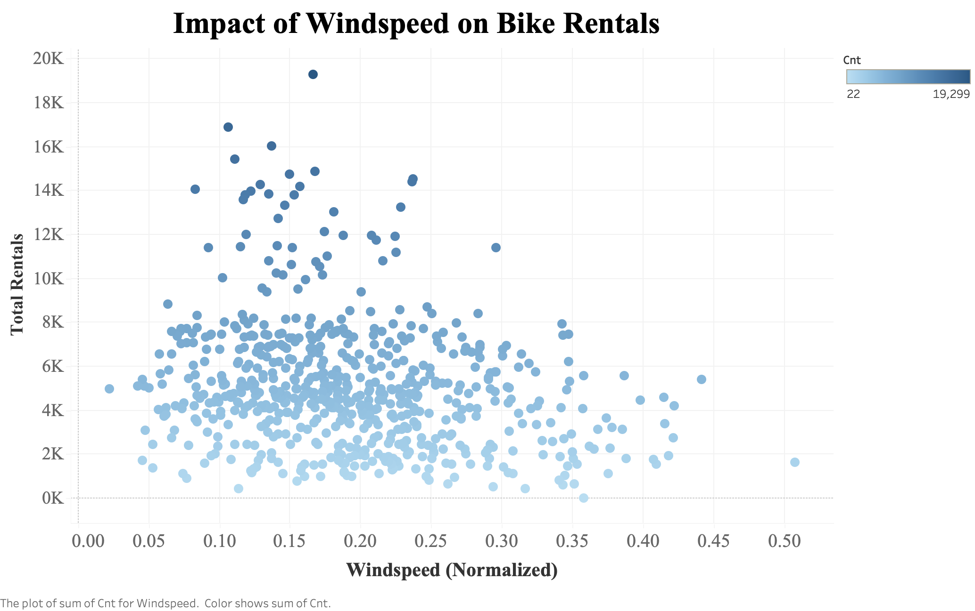
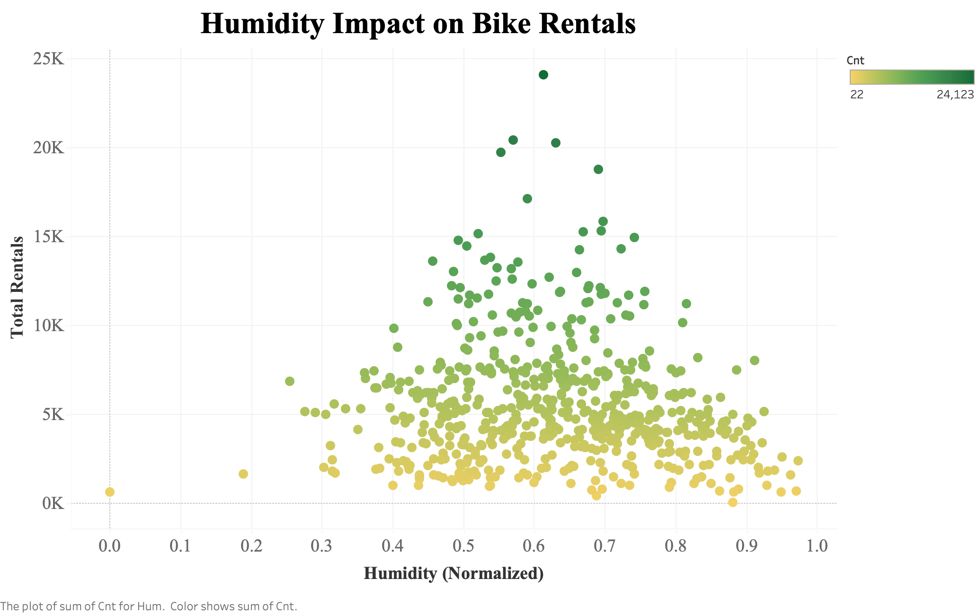
Storm

Slide 7
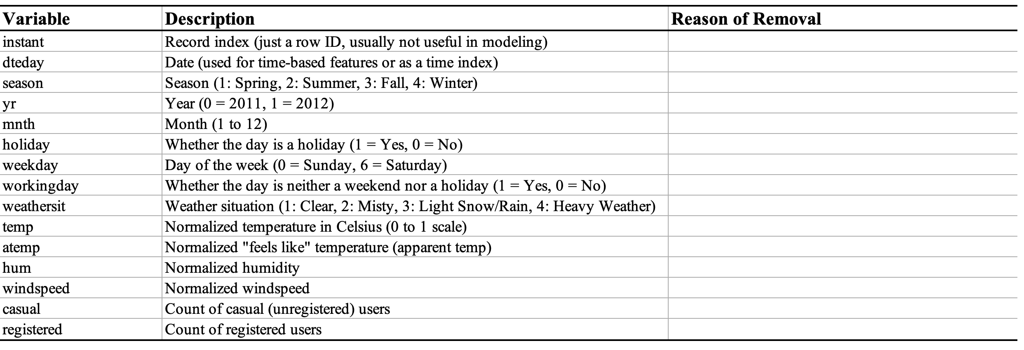
Variables Selection
Spurious correlation
Removed only in Linear Regression
Multicollinearity and redundancy
Will show insignificant high P value
Multicollinearity and redundancy
Choose Temp, Remove Atemp
Leakage: Directly sum to the target cnt.
Notes:
During feature selection, I dropped several variables:

Slide 8
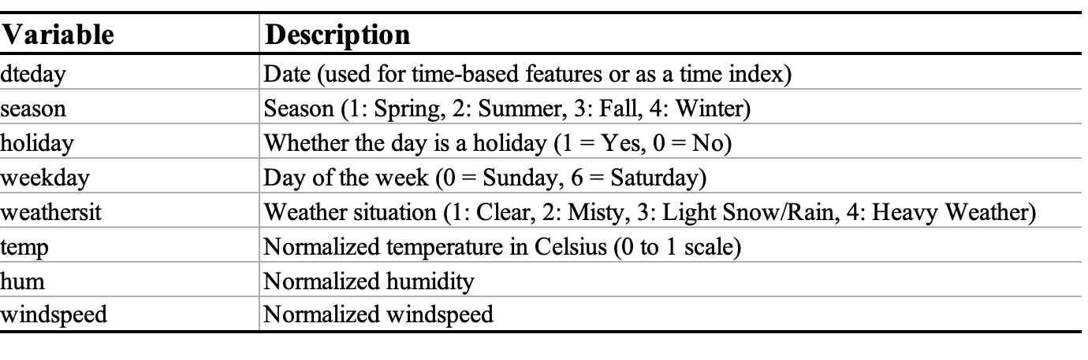
Variables Selection
Set | Rows | Date Range | Purpose
Training | 1–718 | Before 2012-12-17 | Fit the model using past data
Testing | 719–732 | 2012-12-17 to 2012-12-31 | Predict unseen future 2 weeks period values
Notes:
After filtering, I finalized the variables shown here.
For modeling, I split the dataset into training and testing sets:

Slide 9
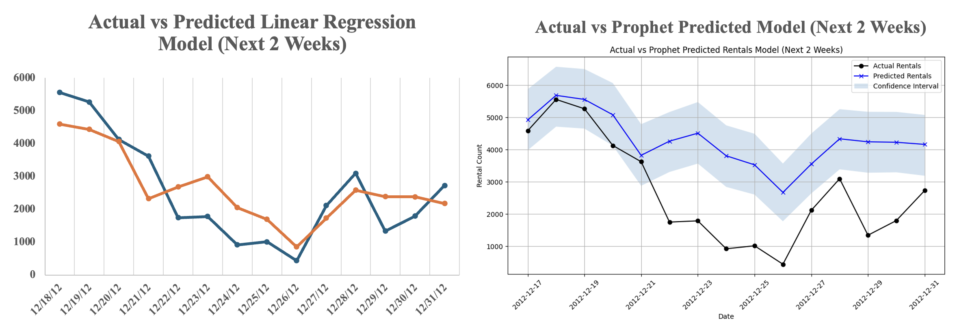
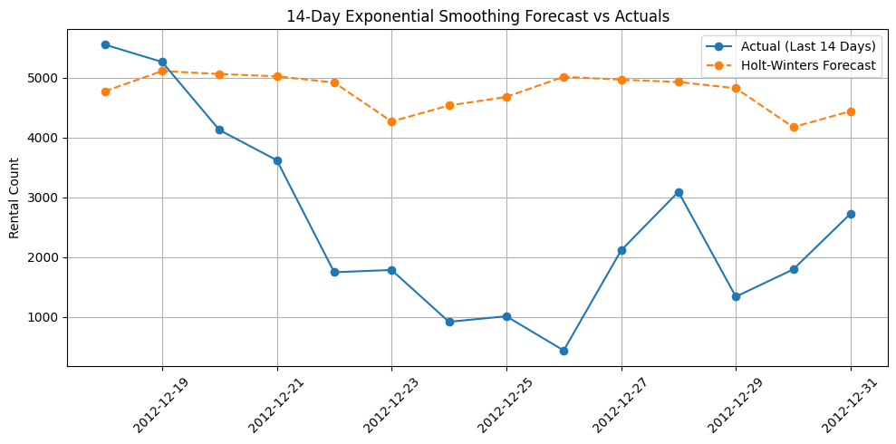
Models & Comparison
Actual vs Holt Winter Predicted Model (Next 2 Weeks)
MAE: 2362.12
RMSE: 7108712.69
R² Score: 0.0223
MAE: 757.4534
RMSE: 832.6412
R² Score: 0.7086
MAE: 1613.61
RMSE: 1905.58
R² Score: 0.1533
Notes:
In this project, I compared three models to forecast bike rentals over a two-week horizon: Holt-Winters Exponential Smoothing, Prophet, and Linear Regression.
Holt-Winters, while simple and fast, captured slight sudden demand drops like holidays.
Prophet captured sharp drops and behavioral shifts—such as during holidays—but struggled to model the overall trend accurately
Linear Regression, although not a traditional time series model, outperformed both. It excluded direct time variables to avoid leakage, and instead relied on external drivers like temperature, humidity, and weekday. These contextual features captured the demand patterns well.
This shows that when feature engineering is done well, a simple model like Linear Regression can outperform more complex time series models. In this case, it proved to be the most interpretable and effective option for short-term operational forecasting.

Slide 10
Summary
Model Selection
Linear Regression was chosen here.
Application Analysis
Use weather forecasts to prepare in advance to reduce cost, e.g. increase bike availability during clear weekends and reduce staffing or reallocate bikes on rainy days.
Offer discounts or scale back bike availability during extreme hot or cold seasons.
Schedule bike maintenance during seasonal lows, like winter, to avoid disrupting peak usage.
Shift bikes to office zones during workdays, where commuting demand is higher.
Suggestions
Compare more time series models to evaluate predictive performance.
Use cross-validation techniques to ensure robustness and avoid overfitting.
Adding more detailed variables to improve model accuracy, e.g. specific holiday names, event data.

